Slide 1
Promoting Deep and Wide Thinking / Early Dual Degrees in Basic Sciences (ThinkBS)
Project nº: 2019-1-TR01-KA203-077194
TEAM MEETING AT UNIDEB

Slide 2
Contents
Transnational Project Meetings
Kick-off Meeting
Time Table of Meetings
Intellectual Outputs
O1. Curricula Design
Lectures
O2. Educational Material
Summer Courses
O3. Educational Platform
Multiplier Events
Learning, Teaching, Training Activities
Financial Report

Slide 3
Transnational Project Meetings
ID | DATE | Meeting Title
TPM 1 | 2019 | Kick-off Meeting in Turkey
TPM 2 | 28 January 2022 | Project Progress Assessment Meeting in Spain
TPM 3 | 02 June 2022 | Progress meeting. Intermediate in Hungary
TPM 4 | 15 July 2022 | Project Results Evaluation. Final meeting in Romania

Slide 4
Meeting Content on Proposal
Project Meeting 3: Project Progress Assessment Meeting HU
To share and discuss the development of the learning platform (IO3) and distribute tasks regarding its development and updating.
To define the objectives of the intensive programmes (C2*), and agree on teaching&learning and assessment methodologies, lecturers’ selection, learning outcomes, etc.
To define materials development for C2. Organization of summer school, year 2
*C2: Summer School in Romania

Slide 5
Iı. Intellectual Outputs
O1. CURRICULA DESIGN: Blended Learning Curriculum
Lectures
O2. EDUCATIONAL MATERIAL: BLENDING LEARNING AND SUMMER COURSES
Summer Courses
O3. EDUCATIONAL PLATFORM FOR BLENDING LEARNING

Slide 6
O1. CURRICULA DESIGN: Blended Learning Curriculum
Unideb - Hungary
Code | Name | Level
ThinkBS-206 | Introduction to Artificial Intelligence | Intermediate
ThinkBS-401 | Topology and Geometry | Advanced
ThinkBS-309 | Markov Chains and Their Applications | Upper
ThinkBS-410 | Introduction to Real and Complex Analysis | Advanced
ThinkBS-404 | Tomography | Advanced
ThinkBS-405 | Mathematics of Diagnostics | Advanced

Slide 7
UPB - Romania
Code | Name | Level
ThinkBS-306 | Advanced Statistical Methods with Applications in Engineering and Medicine | Upper
ThinkBS-305 | Innovative Mathematical Modelling Techniques: Fractional Calculus, Wavelet Analysis, and Estimating of Nonlinearities | Advanced
ThinkBS-304 | Innovative Techniques for Data Security | Advanced
ThinkBS-207.1 | Linear Programming in Optimization Problems | Advanced
ThinkBS-207.2 | Optimization of Transport and Assignment Activities | Advanced

Slide 8
Usj - spaın
Code | Name | Level
ThinkBS-203 | Basic Statistics | Intermediate
ThinkBS-204 | Discrete Mathematics | Intermediate
ThinkBS-205 | Software Tools for Mathematics | Intermediate
ThinkBS-303 | Modeling with Ordinary Differential Equations | Intermediate
ThinkBS-403 | Modeling with Partial Differential Equations | Upper
ThinkBS-402 | Biomathematics | Upper

Slide 9
Khas - Turkey
Code | Name | Level
ThinkBS-201 | Advanced Linear Algebra | Intermediate
ThinkBS-202 | Advanced Calculus | Intermediate
ThinkBS-307 | Calculus on Manifolds | Intermediate
ThinkBS-301 | Abstract Algebra | Upper
ThinkBS-302 | Partial Differential Equations | Upper
ThinkBS-308 | Multivariate Statistics | Upper
ThinkBS-409 | Synchronization from the Mathematical Point of View | Upper

Slide 10
What was on the proposal?
1st level Advanced Linear Algebra, Advanced Calculus, Engineering Electives (8 courses)
2nd level Abstract Algebra, Partial Differential Equations, Engineering Electives (8 courses)
3rd level Topology and Geometry, Introduction to real and complex analysis, Engineering Electives (8 courses)
Intermediate
Upper
Advanced
ThinkBS-201 | Advanced Linear Algebra
ThinkBS-202 | Advanced Calculus
ThinkBS-203 | Basic Statistics
ThinkBS-204 | Discrete Mathematics
ThinkBS-307 | Calculus on Manifolds
ThinkBS-205 | Software Tools for Mathematics
ThinkBS-206 | Introduction to Artificial Intelligence
ThinkBS-303 | Modeling with Ordinary Differential Equations
Abstract Algebra | Upper
Partial Differential Equations | Upper
Topology and Geometry | Upper
Modeling with Partial Differential Equations | Upper
Multivariate Statistics | Upper
Markov Chains and Their Applications | Upper
Advanced Statistical Methods with Applications in Engineering and Medicine | Upper
Biomathematics | Upper
Introduction to Real and Complex Analysis | Advanced
Innovative Mathematical Modelling Techniques: Fractional Calculus, Wavelet Analysis, and Estimating of Nonlinearities | Advanced
Innovative Techniques for Data Security | Advanced
Linear Programming in Optimization Problems | Advanced
Optimization of Transport and Assignment Activities | Advanced
Synchronization from the Mathematical Point of View | Advanced
Tomography | Advanced
Mathematics of Diagnostics | Advanced

Slide 11
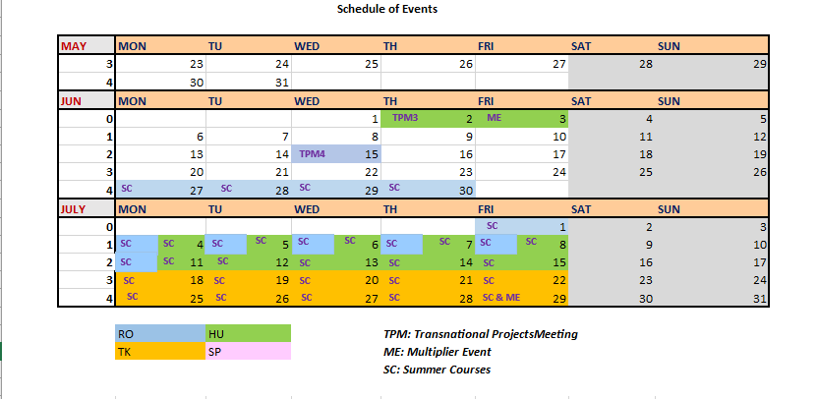
O2. EDUCATIONAL MATERIAL: BLENDING LEARNING AND SUMMER COURSES

Slide 12
Re-Scheduling
TMP4 – Romania: 15 July
Multiplier Event - Turkey: 29 July
Summer Courses:
1st Summer Course in Hungary: 4-15 July
2nd Summer Course in Romania: 27 June-11 July
3rd Summer Course in Turkey: 18-29 July

Slide 13
'Call for Participation' for the Summer Courses
By USJ
Warnings from National Agency
!!! has to be 2 weeks long : There may be conflicts…
Information of these courses with dates
Requirements of the participants or the ideas that may arise as to how to select the participants.
Certificates

Slide 14
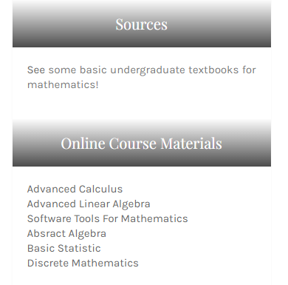
O3 EDUCATIONAL PLATFORM FOR BLENDING LEARNING
OUTCOMES
Course curriculum for a minor in mathematics.
24 courses segmented in three levels of difficulty. (Lecture videos, course contents and references)
http://thinkbs.khas.edu.tr/all_courses.php
Online platform for supporting the blended learning environment.
TARGETS
3 summer schools for 100+ students.
1000+ course registrations, 400+ successful completion, 20+ certified students
http://thinkbs.khas.edu.tr/

Slide 15
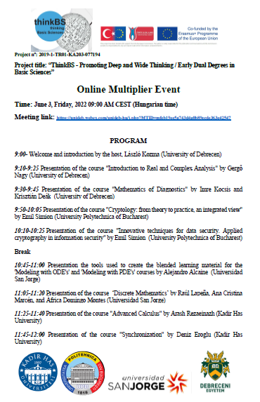
MultIplIer Events
Learning, Teaching, Training Activities

Slide 16
MultIplIer Events

Slide 17
Fınancıal Report

